Slide 1


DSCI 6004: NLP Project
Team Members: Shraddha Shrestha || Mallikarjun Aitha
Notes:
Hello! I’m Mallikarjun and my teammate is Shraddha, we are here to present our project which focuses on building a RAG system.

Slide 2


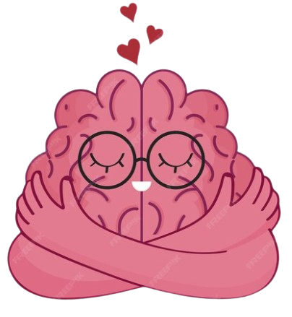
Project: MindMate
Domain
Mental Health – Enhancing chatbot responses with reliable, context-aware information for mental health queries
Notes:
Our project is about building Mind-Mate, which is mental health chatbot. It responds with reliable, context-aware information for mental health queries.

Slide 3
Project Objectives
Developing and applying RAG systems using 3 different LLM models in Mental Health Domain.
Evaluate and Compare the performance of the Large Language Models.
Access how effectively the model adhere to ethical guidelines, avoiding harmful or misleading advice.
Notes:
Our project had three main objectives:
Develop a RAG system using three different LLMs.
Evaluate and compare the performance of these models.
Ensure the models adhere to ethical guideline.

Slide 4
Statement of Value
Breaking the Stigma: Provides a private, judgement-free space for those hesitant to seek therapy.
Affordable Access: Offers free, on-demand mental health support, reducing financial barriers.
Self-Assessment: Helps users gauge their mental health and decide if professional help is needed.
Notes:
We believe MindMate provides important value: It offers a private, affordable space for users to explore mental health concerns. It provides on-demand support and helps users assess when professional help might be needed."

Slide 5
Review of the State of Art
Papers Taken as Reference
SouLLMate: An Application Enchancing Diverse Mental Health Support with Adaptive LLMs, Prompt Engineering, and RAG Techniques
An adaptive mental health support system using LLMs, RAG, and prompt engineering
Includes Risk Detection, Proactive Guidance, and personalized profile uploads.
LLM Therapist: A RAG-Based Multimodal Behavioral Therapist as Healthcare Assistant
Key takeaways:
LLMs enable human-like text generation and understanding
LLM-Therapist provides personalized mental healthcare using multimodal data
RAG improves response accuracy and efficiency
Notes:
"We referenced two major works:
SouLLMate, which adapts LLMs for mental health support using RAG techniques, risk detection, and proactive guidance.
LLM-Therapist, a multimodal RAG system acting as a behavioral healthcare assistant. These inspired our focus on combining retrieval and model personalization

Slide 6
LLMs used
Mistral-7B-Instruct-v0.2-GGUF
Llama-2-7B-Chat-GGUF
Phi-3-Mini-4k-Instruct-GGUF
Deployment Platform: Streamlit
Datasets:
The Body Keeps the Score
Fundamentals of Psychology
Trauma and Recovery
Approach
Notes:
The approach that we followed is by using three LLMs: Mistral-7B, Llama-2-7B, and Phi-3-Mini Quantized models
Deploying everything on Streamlit for an interactive experience.
We built our knowledge base from three published sources on psychology and trauma

Slide 7
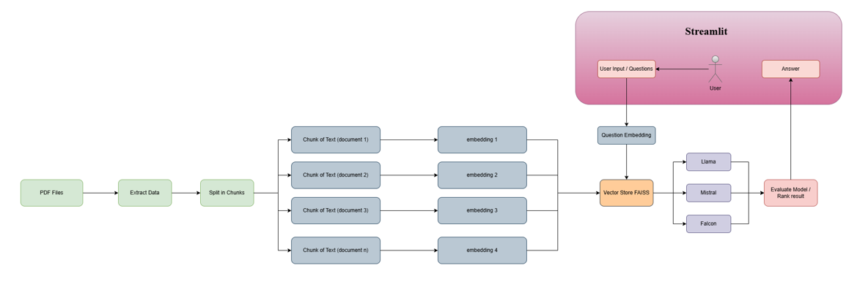
System Architecture
Notes:
"Our system starts by loading PDF files and extracting their text. We split the text into chunks and then convert these chunks into embeddings using a sentence transformer. These embeddings are stored in a FAISS vector store for fast retrieval. When a user asks a question, we fetch relevant chunks, pass them along with the question to our LLMs, and generate context-aware answers, which we then evaluate using various metrics."

Slide 8
Evaluation Metrics
Perplexity
Hallucination Rate
Sentiment Polarity
Sentiment Subjectivity
Notes:
"We evaluated model responses based on:
Perplexity: to measure fluency and predictability.
Hallucination Rate: to quantify made-up information.
Sentiment Polarity and Subjectivity: to assess tone and neutrality. These metrics helped us systematically compare model performances."

Slide 9
Deliverables & Code Demo
build_vectorstore.py: Builds FAISS vectorstore from mental health PDFs
medibot.py: Streamlit web app for multi-model mental health chatbot
llm_evaluation.py: Batch evaluation of LLMs on domain-specific questions
Evaluation output: CSV file with perplexity, hallucination, sentiment scores
Final project report: Research paper which will be uploaded in the git at Mind-Mate
Notes:
Our deliverables includes building a chatbot, Batch evaluation of LLMs on domain-specific questions and storing responses and evaluation metrics in CSV file for analysis. A report detailing the entire project process and findings. Now let’s go into the code demo.
"First, we have the build_vectorstore.py script.
This script is responsible for building the FAISS vector store:
It loads the PDFs from our dataset folder.
It splits the long documents into small overlapping chunks.
Then it generates embeddings for each chunk using a MiniLM sentence transformer.
Finally, it stores all the embeddings inside a FAISS database for efficient retrieval during question answering.
"Next, we have the llm_evaluation.py script.
This file evaluates all three models — Mistral, Llama, and Phi-3 — across a set of 10 carefully designed mental health questions.
Here's what it does:
It downloads or loads the local model files from hugging face repositories
For each model, it retrieves relevant chunks from the FAISS database based on the question.
It sends the retrieved context and the question into the model using a prompt template.
All three models were loaded locally using the llama-cpp library,
It records the answer, and calculates four important metrics:
Perplexity (for language fluency)
Hallucination Rate (how much is made up)
Sentiment Polarity and Subjectivity (emotional tone and neutrality)
Finally, it saves all the results into a CSV file.
This gives us a batch evaluation to compare model performances side-by-side."
"Finally, we have mindmate.py, our Streamlit app.
This app is designed for real-time interaction:
A user can type a mental health-related question.
They can select one or multiple models from the sidebar.
The app retrieves context from the FAISS database.
Then it sends the context + question into the selected LLMs.
It displays each model’s answer, and the corresponding metrics (hallucination rate, perplexity, polarity, and subjectivity) in real-time.
Users can also expand and view the exact source context retrieved for transparency.

Slide 10
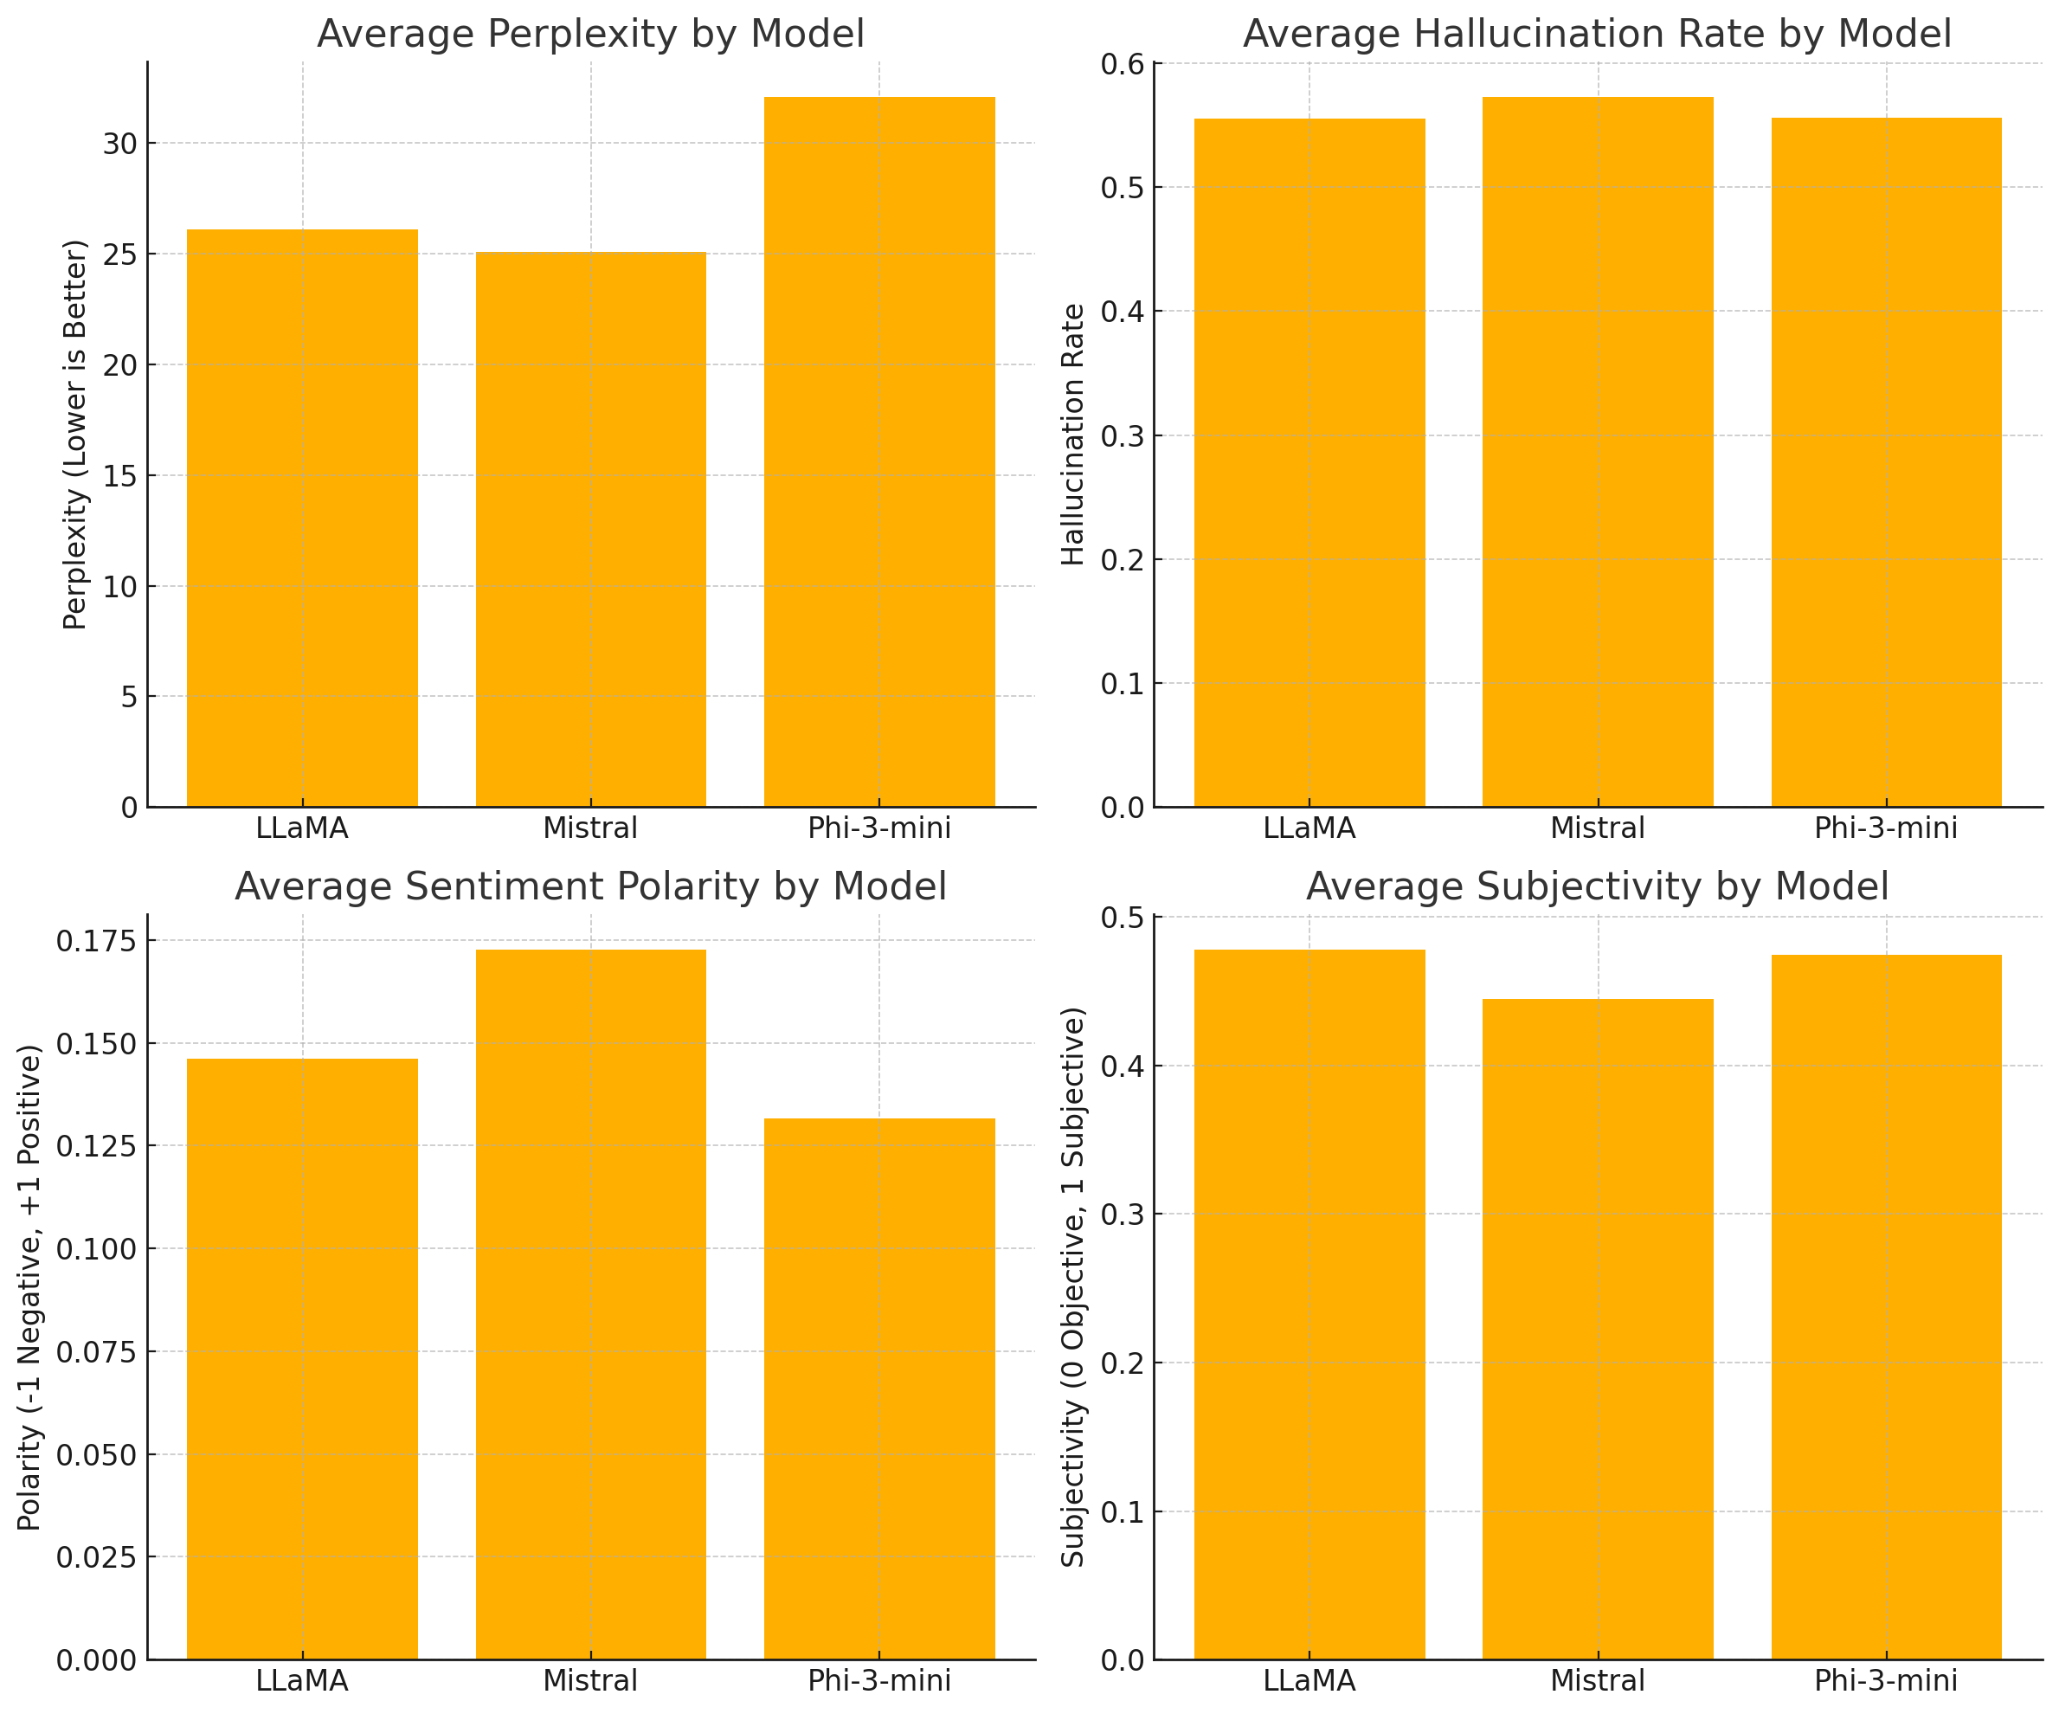
Evaluation Summary
Phi-3 Mini -- Lowest Hallucination rate
Mistral-7b – Best fluency (Lowest Perplexity)
All models – Netural, objective tone
Notes:
In this evaluation, we found that Phi-3 Mini continued to show the lowest hallucination rate, maintaining strong grounding in the retrieved information. Mistral-7B achieved the lowest perplexity, indicating it generated the most fluent and coherent responses. Across all models, the sentiment remained mostly neutral and objective, which is critical for addressing sensitive mental health topics appropriately

Slide 11
Reference
F. R. Shafi and M. A. Hossain, "LLM-Therapist: A RAG-Based Multimodal Behavioral Therapist as Healthcare Assistant," GLOBECOM 2024 - 2024 IEEE Global Communications Conference, Cape Town, South Africa, 2024, pp. 2129-2134, doi: 10.1109/GLOBECOM52923.2024.10901139.
Guo, Q., Tang, J., Sun, W., Tang, H., Shang, Y. and Wang, W., 2024. SouLLMate: An Application Enhancing Diverse Mental Health Support with Adaptive LLMs, Prompt Engineering, and RAG Techniques. arXiv preprint arXiv:2410.16322.
Notes:
"For our references, we mainly cited the SouLLMate paper from arXiv and the LLM-Therapist study from the IEEE Global Communications Conference. Both papers provided a strong foundation for adapting RAG in the mental health domain."

Slide 12
Thank You!
Notes:
"Thank you for listening to our presentation! We will soon share our project code, findings and results on github"

